Slide 1

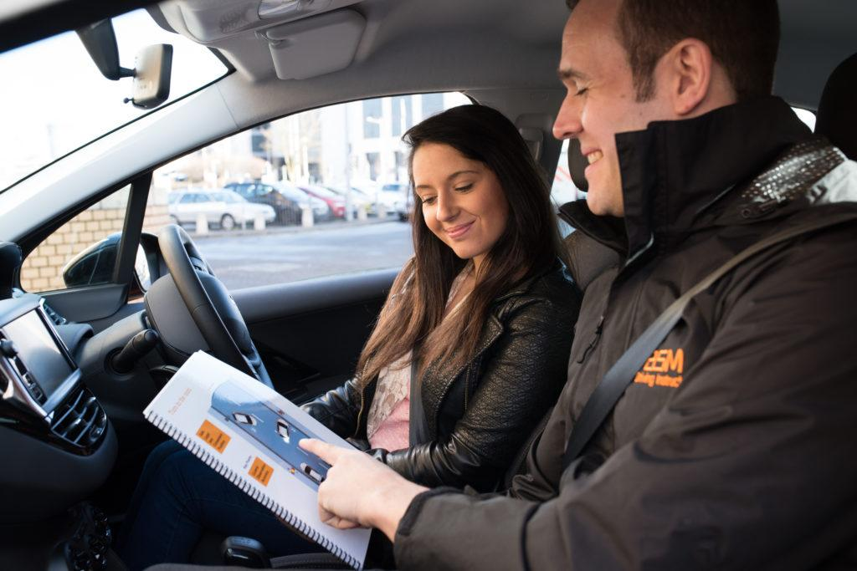
Driver Coach
feedback
A driving coach for everyone
to make driving safer
Sharing information to reduce traffic accidents
Tauvic Ritter, 2020-12-08, https://github.com/Tauvic/DriverAwareness

Slide 2
Contents
Contents
Introduction
Purpose and scope of this presentation
Traffic accidents don’t just happen, the have causes
Vehicle Driving Safety monitoring system
Distracted driving and dangerous behaviour increase risk
How to identify and prevent risky situations
Providing feedback to driver to reduce accidents
Road safety ECO system
Multi party information sharing can make driving safer
Signalling dangerous situations without fear for repercussion
How drivers and organisations work together to make driving safer
What to do next
feedback
Personal driver coach

Slide 3
Purpose and scope of this presentation
Intro
To provide insights
To show what is possible
To start a discussion
To inspire
To move you into action
It’s an active working document
It’s part of a greater project
This is not a design poured in concrete
Its open for discussion
We need your expertise to make it happen

Slide 4


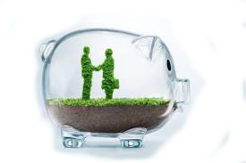
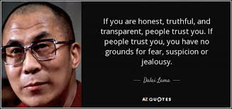
What really matters in life
Intro
Safety
Privacy
Transparency
Trust
We all have our own responsibility to take action

Slide 5
What we can learn from near misses
Traffic accidents
Small errors, mistakes and dangerous behaviour are predictors for more serious events.
We should keep track of every incident (no matter how small) and learn from it.
We should be more aware of our own behaviour. This may feel intrusive but injuries hurt a lot more!
Fatal injuries
Major injuries
Cost & Impact
Minor injuries
Near misses
Small errors, mistakes, dangerous driving

Slide 6
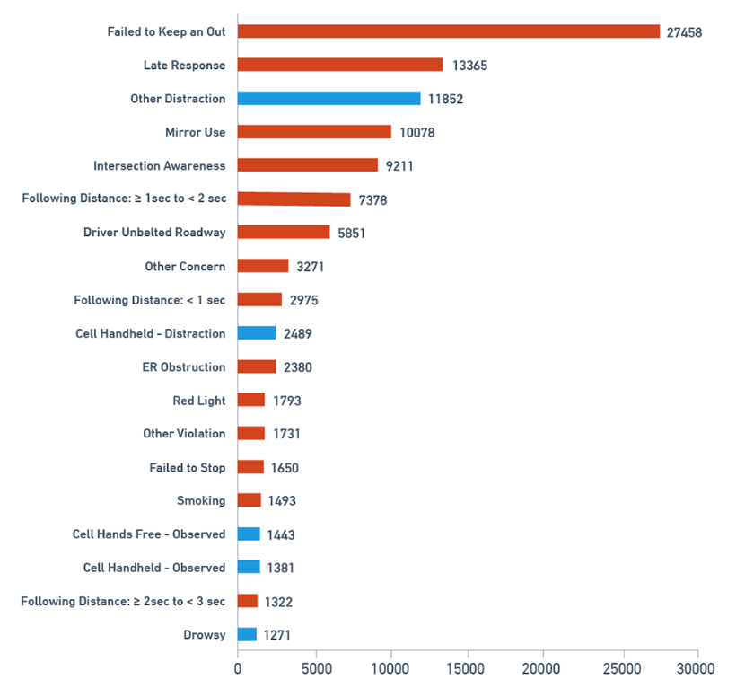
Causes of near misses
Traffic accidents
The chart below shows some of the top behaviors
and how they contribute to near collisions
What would happen if we could reduce some of these causes?

Slide 7
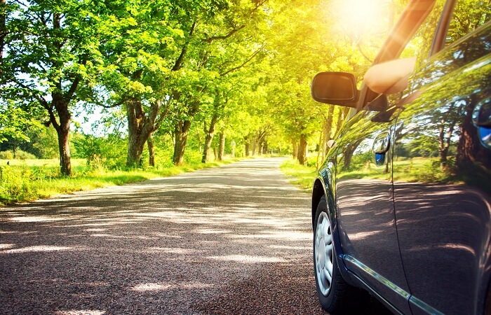
You drive the same road every day
Traffic accidents
You know it by heart
Every turn
Every tree
Nothing special
That’s when you start day dreaming
"It came out of nowhere!"

Slide 8
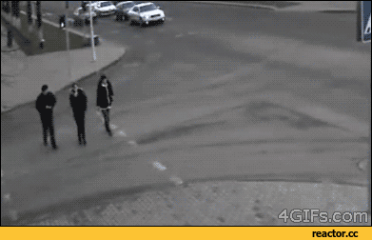
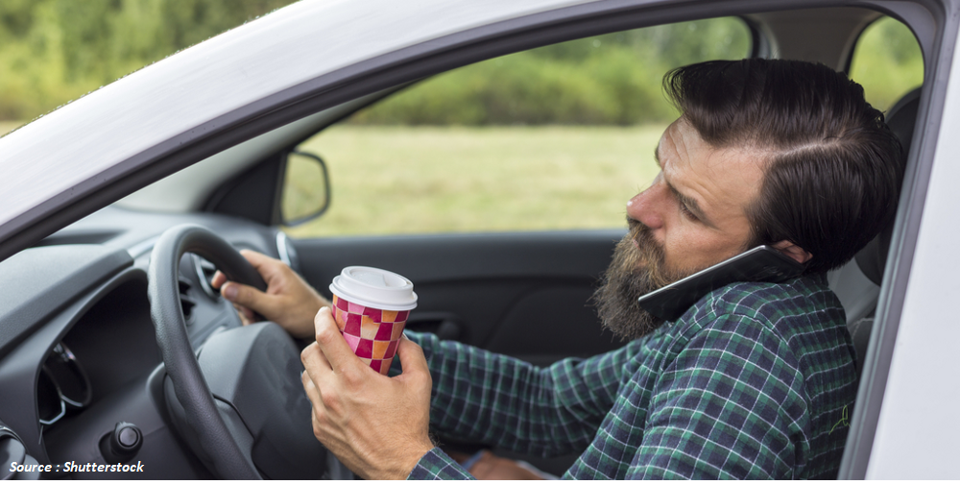
We are all perfect drivers, but
Traffic accidents
We sometimes forget what we have learned
We are so hungry
We are so busy
We get tired
It came out of nowhere
So human, so busy, totally unaware

Slide 9
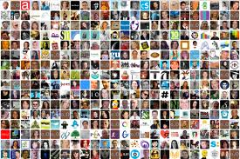
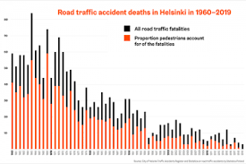
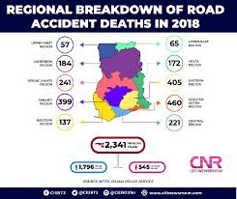
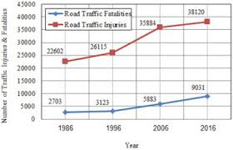
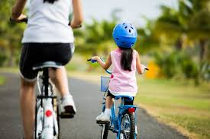
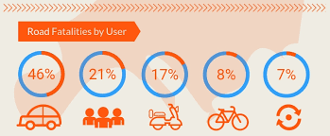
This results in Road Accident Statistics
Traffic accidents
According to the British Royal Society for the Prevention of Accidents, driver fatigue contributes up to 20% of road accidents and up to a quarter of fatal and serious accidents. The statistics are that an estimated 1,550 deaths, 71,000 injuries, and $12.5 billion in monetary losses each year due to driver fatigue. ………..
Other studies show numbers ranging from 20% up to 50%
source: https://www.rospa.com/rospaweb/docs/advice-services/road-safety/drivers/fatigue-litreview.pdf
I don’t want to end up in those statistics

Slide 10
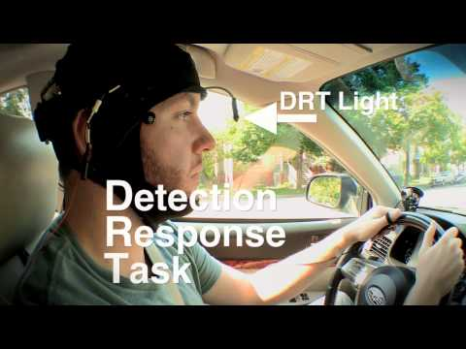
We are all perfect drivers, but
Traffic accidents
Research
We miss what happens around us
By tracking head and eye movement we can evaluate our level of situational awareness

Slide 11
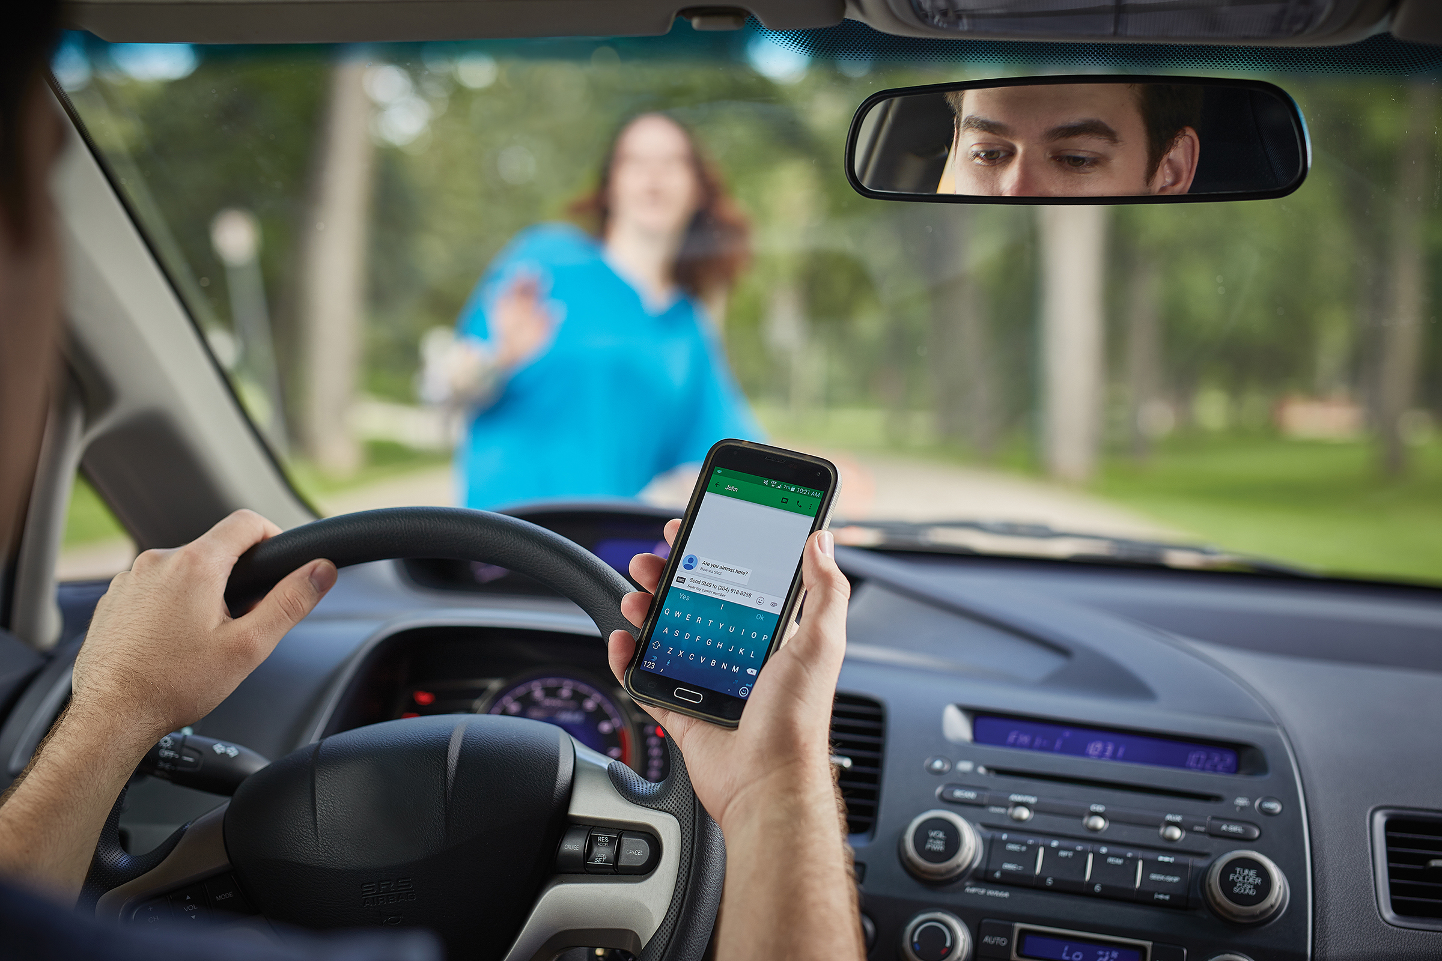
What are our major distractions?
Traffic accidents
Distractions
Resolutions
We get distracted by our phone
We are hungry or tired
We get day dreaming
We should disable the phone
We should be in good physical shape
We should be focused
There are four types of driver distraction:
Visual – looking at something other than the road.
Auditory – hearing something not related to driving.
Manual – manipulating something other than the steering wheel.
Cognitive – thinking about something other than driving.
With so many potential distractions we tend to easily forget how we should drive safely. Hence we should be constantly reminded of that.

Slide 12
360 degree awareness
Traffic accidents
Good driving habits
Bad driving habits
Wearing seat belt
Active driving posture
Hands on the steering wheel
Looking in the general driving direction
Checking for traffic from all directions
Left/right/rear mirror checking
Signalling direction changes to other drivers
Operating the console (NAV / media / airco)
Talking to passengers
Eating or drinking
Other activities (reaching for something, singing)
Ugly driving habits
Falling asleep
Mobile phone usage (handheld, call, texting)

Slide 13
What can we do about it
Traffic accidents
Reactive
Public transport
Get a bigger car
Stop driving
Repair the damage
Hire a driver
Buy a
Tesla
Garage
Problem
$ cost $
Roadside Assistance
Hospital
Preventive
Driver Monitoring System
Insurance
Take more
breaks
Driving
school
Awareness
training

Slide 14
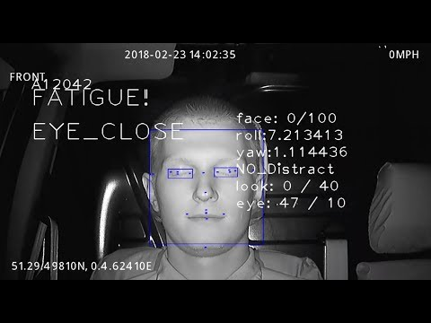
Driver Monitoring System (drowsiness)
Driver Coach
Warns when driver is tired
Detects only drowsiness
Build-in in expensive cars
Most regular cars don’t have this feature
Effect on safety is limited

Slide 15
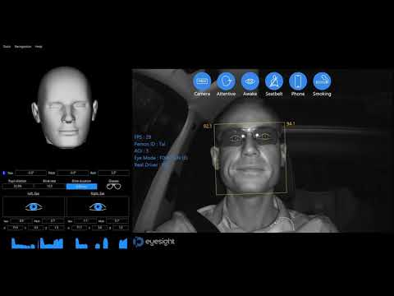
Driver Monitoring System (distractions)
Driver Coach
Detects:
Drowsiness
Wearing a seatbelt
Distractions
Holding a phone
Smoking
Effect on safety is better but still not complete

Slide 16
Driver Monitoring System (driving skills and style)
Driver Coach
Detects:
Drowsiness
Distraction
Driving skills
Steering
Acceleration/ Deceleration
Braking (timing)
Gear (timing, gear selection)
Driving style
Driver alertness
Mirror checking
Over the shoulder checking
Indicator lights usage
Stop signs / traffic lights
Getting a complete driver profile can make driving safer

Slide 17
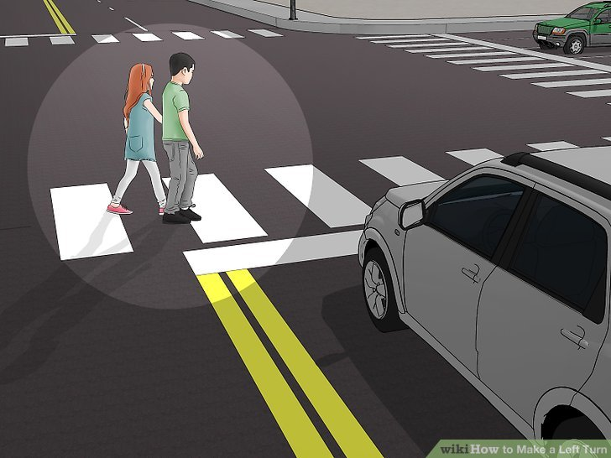
Example: making a proper left turn
Driver Coach
Assess the traffic situation
Allowed to do (legal, traffic rules)
Should i do (is it safe, sensible)
Check rear mirror
Use direction indicator lights
Slow down
Come to a full stop
Watch out for other traffic
When traffic allows
Check side and mirrors
Turn left

Slide 18
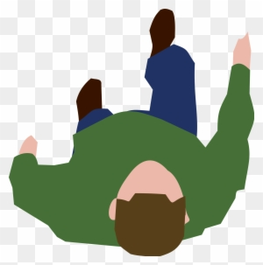
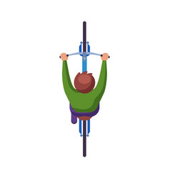
Driver situational awareness
Driver Coach
Look left
Vehicle
Driver
Look forward
Driving direction
Look right (over shoulder)

Slide 19
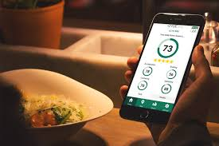

Provide feedback to the human in the loop
Driver Coach
Safe driving
rules
Traffic
rules
Driver Monitoring
Sensor Input
Controls
Car

Slide 20
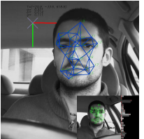
Sensors
Features
Driver state
System services
Driver
recognition
Camera
Display
Infrared
Head pose
Alert
Acceleration
Buzzer
Algorithm
Gaze direction
Velocity
Machine learning
Distracted
Processor
Eyes closed / blink
Drowsy
Memory
GPS location
State machine
Hand position
Storage
Indicator lights
Rules &
parameters
Distraction
Network
System diagram
Might have
Must have

Slide 21
Let’s take a step backward
And view it from a higher perspective

Slide 22
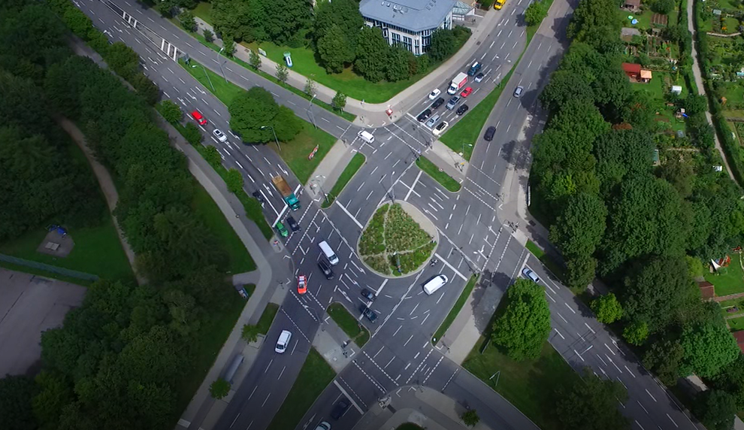

Slide 23
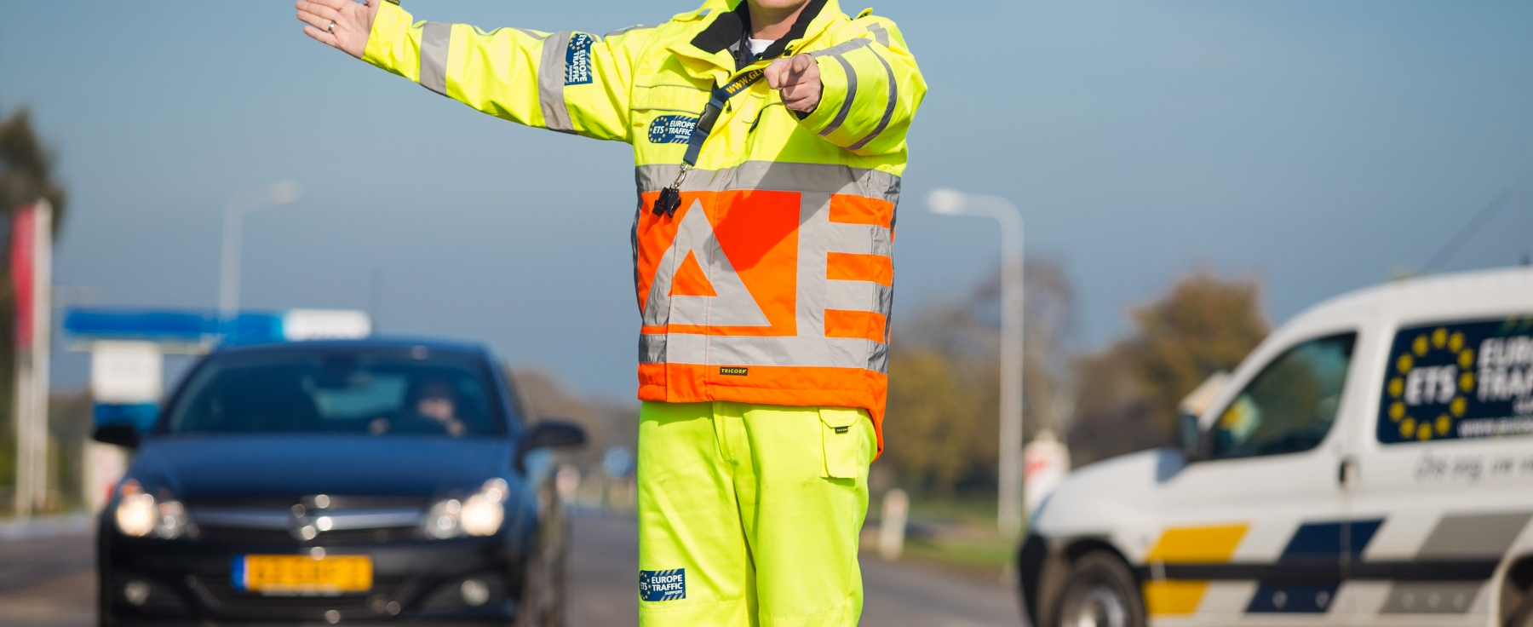
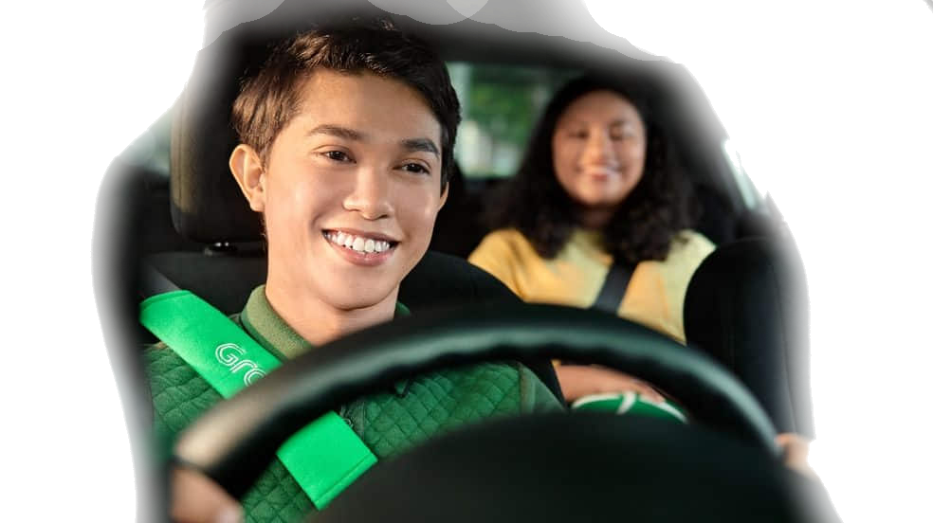
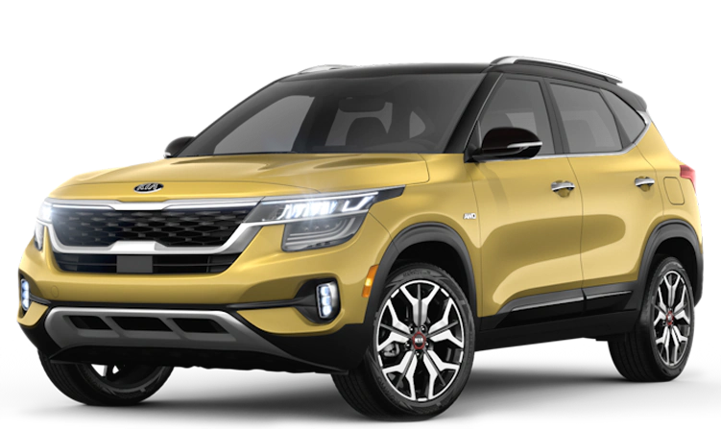
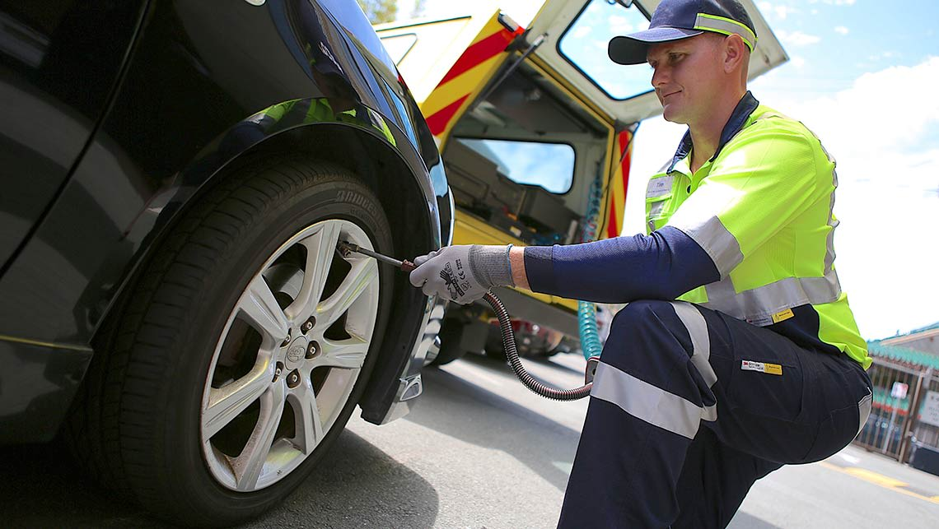
Vehicle driving ECO system
ECO system
Environment
Road design
Road conditions
Traffic / Pedestrians
Weather
Vehicle
Physics
Safety features
Driver
Driving skills / style
Experience / attitude
Mental/Physical state
Government
Manufacturer
Environment
Consumer interests
Insurance
Road side assistance

Slide 24
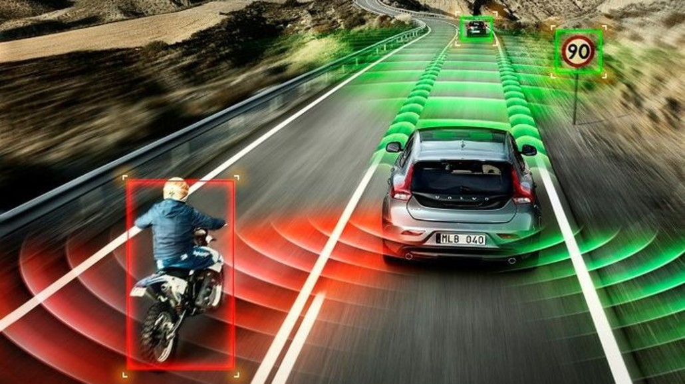
Every vehicle can sense itself, its driver and its environment
ECO system
Vehicle sensors collect data
Vehicle
Driver
Road conditions
Other road users
This data can provide valuable feedback
Vehicle ⇒ traffic density, speed, environmental impact
Driving style ⇒ improve your driving, reduce accidents, reduce insurance costs
Road safety ⇒ unsafe situations, improve roads, make your neighborhood safer
Oher road users ⇒ Detect near misses
Make driving safer by providing feedback to drivers, road owners and organisations

Slide 25
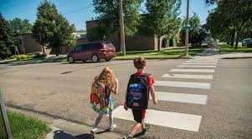
Why should we share data and learn to trust each other
ECO system
Working together on a common goal
To make driving safer
To spot unsafe traffic situations
Raise driver awareness
Reduce number of traffic incidents
Because i want to make my neighborhood safer
To reduce cost for society as a whole
We need to share data
To improve specific traffic situations (share data anonymously with local government)
To make vehicles safer (share driving data anonymously with car manufacturers)
To reduce insurance cost (share driving behaviour with insurance)
To improve my own driving style (calculate driving score and compare anonymously with other drivers)
Make driving safer by providing feedback to drivers, road owners and organisations

Slide 26
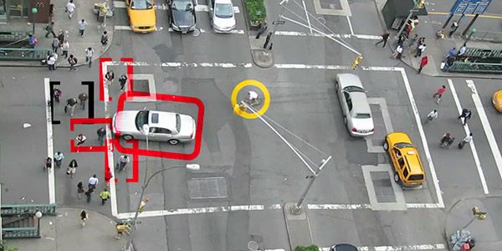
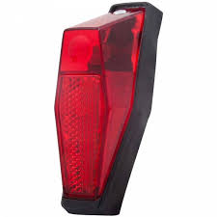
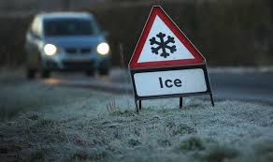
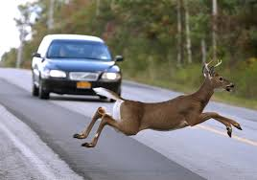
Reporting dangerous traffic situations
ECO system
Accidents / near accidents
Dangerous driving
Confusing traffic situations
Obstacles
Slippery roads
Dysfunctional bicycle lights
Anonymous reporting to gather road safety statistics for making driving safer, not for naming and shaming

Slide 27

But how about security and privacy
ECO system
Requirements
Data ownership
Assured privacy
Driver in control
Local data processing
calculate driver safety score
calculate insurance risk
signal potential unsafe situations
Be GDPR compliant
Share minimum amount of data
Share anonymised data anonymously
Crystal clear algorithms
Vehicle
Private data
Non-private
data
Safe local processing
Anonymous
sharing
Trusted
party
Data ownership, privacy and mutual trust between parties are key

Slide 28
Smart mobility with multiple parties
ECO system
Parties
Driving schools
First responders
Roadside assistance
Insurance company
Car Manufacturer
(Local) Government
Equal playing field
Common infrastructure / architecture
Open interfaces / secured data exchange
All organisations have equal access
Vehicle driver chooses its partners
Open data whenever possible
Vehicle
Private data
Non-private
data
Safe local processing
Anonymous
sharing
Trusted
party
Data ownership, privacy and mutual trust between parties are key

Slide 29
The road to success
Start small with limited scope
Driving Coach for young drivers
Feedback on driver behaviour
Buildup experience
Connect to European road safety and science programmes
Find suitable development and business partners (NGO, GO)
Focus on developing an open ECO system
Open data sharing
Inclusive / not exclusive
Data ownership
Trust
Work on a common goal

Slide 30
What to do next, so many questions
Summary
Questions for the audience:
Will these ideas help to reduce road accidents and make our life safer?
Are there any major issues that hinder this and need to be addressed in more detail.
Think what can you do?
The next step:
Share these ideas within our organisation, mobility partners
Discuss, investigate and experiment to learn more
Look out for partners?
Millions of euro’s are spend each year on Road Safety and scientific research programmes
The average car has safety belts and airbags but does not communicate its story
Let see if we can use innovation to make the road safe again!

Slide 31

Where to find more information
Dutch mobility innovations
https://dutchmobilityinnovations.com/spaces/86/dutch-mobility-innovations
Github project website: https://github.com/Tauvic/DriverAwareness

Slide 32
